Slide 1
Lecture 7 – Code Workshop
Naveh Porat
June 2022

Slide 2
Learning Code
A large portion of the course is dedicated to code.
Today we will see some useful tools and coding concepts.
It’s very hard to teach\learn code because it tends to be very technical.
We’ll try to have everything demonstrated live.
Try to follow along and ask as many questions as you can!

Slide 3
What is good code?
We would like to write code that :
Is easy to use
Is easy to read (by others)
Is easy to modify
Is fast

Slide 4
Table of Contents
01
04
Pycharm
Coding Practices
02
05
VMs
Debugging
03
06
Bash
Loggers

Slide 5
Pycharm - Shortcuts

Slide 6
Text Editing

Slide 7
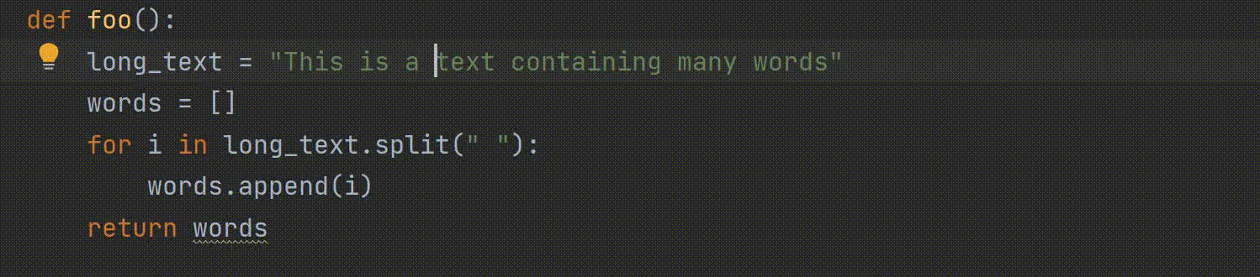
Ctrl + right/left

Slide 8
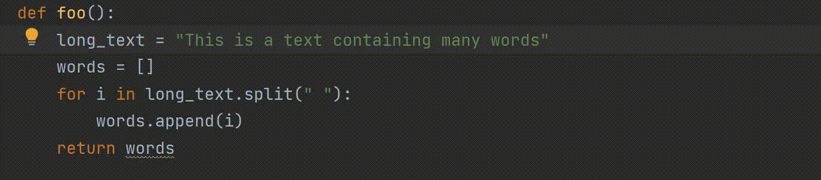
Home & End

Slide 9
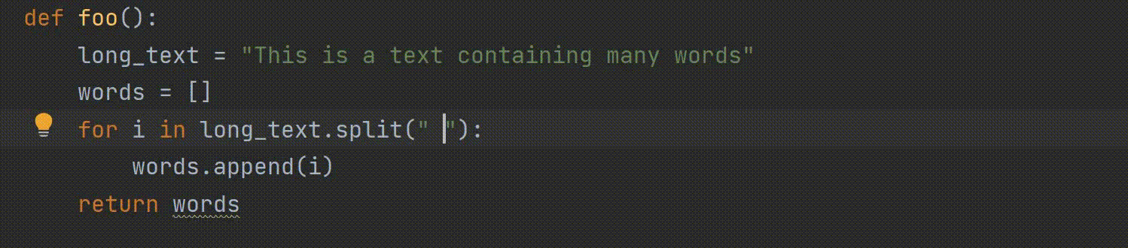
Ctrl + w

Slide 10
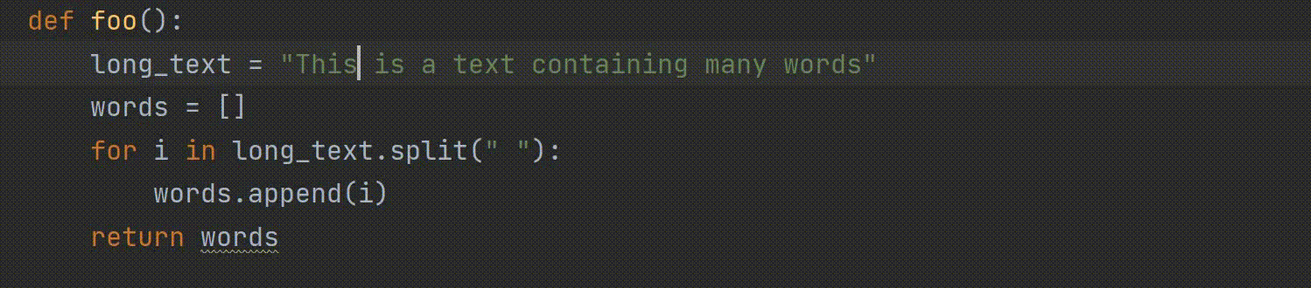
Ctrl + c & Ctrl + v

Slide 11
Ctrl + x & Ctrl +v

Slide 12
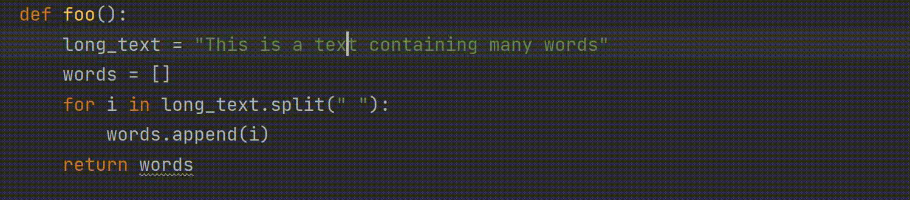
Ctrl + d

Slide 13
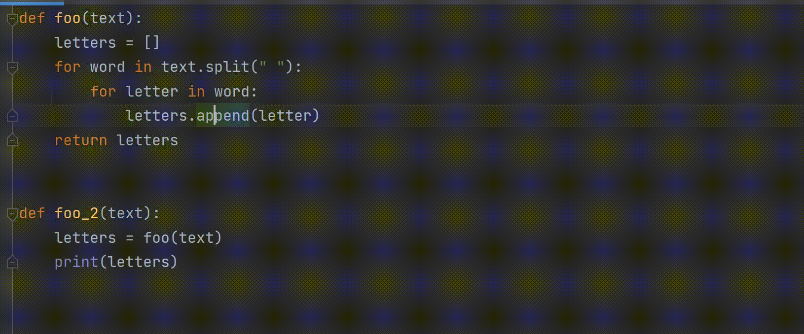
Code Folding

Slide 14

Commenting

Slide 15
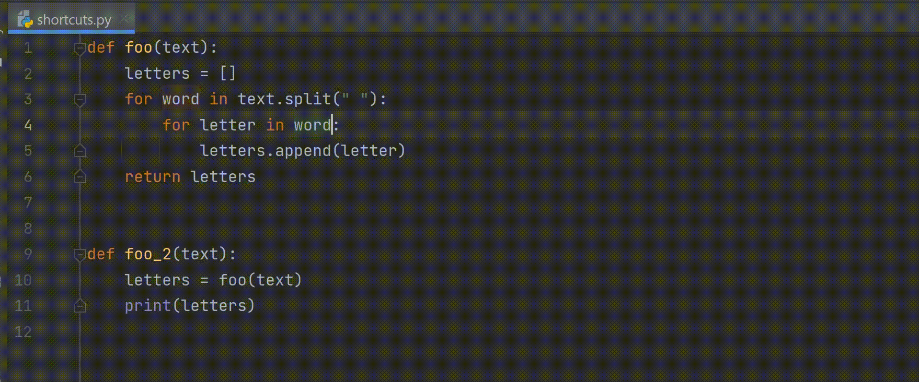
Search & Replace

Slide 16
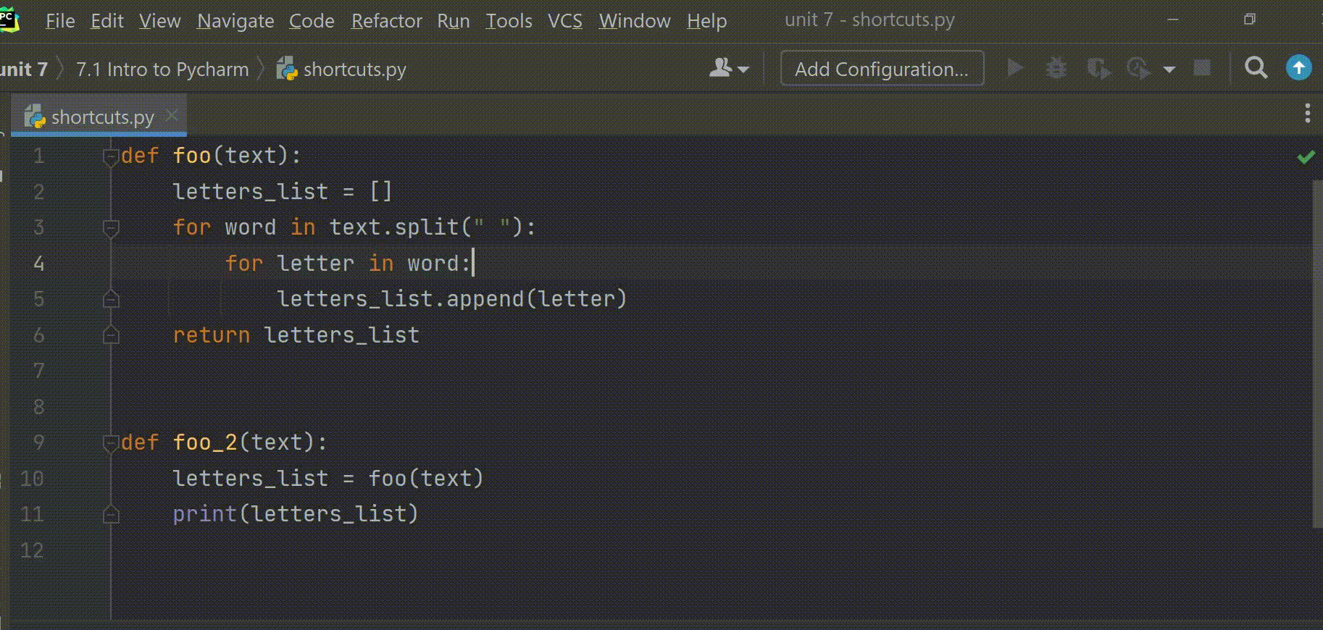
Global Search & Replace

Slide 17
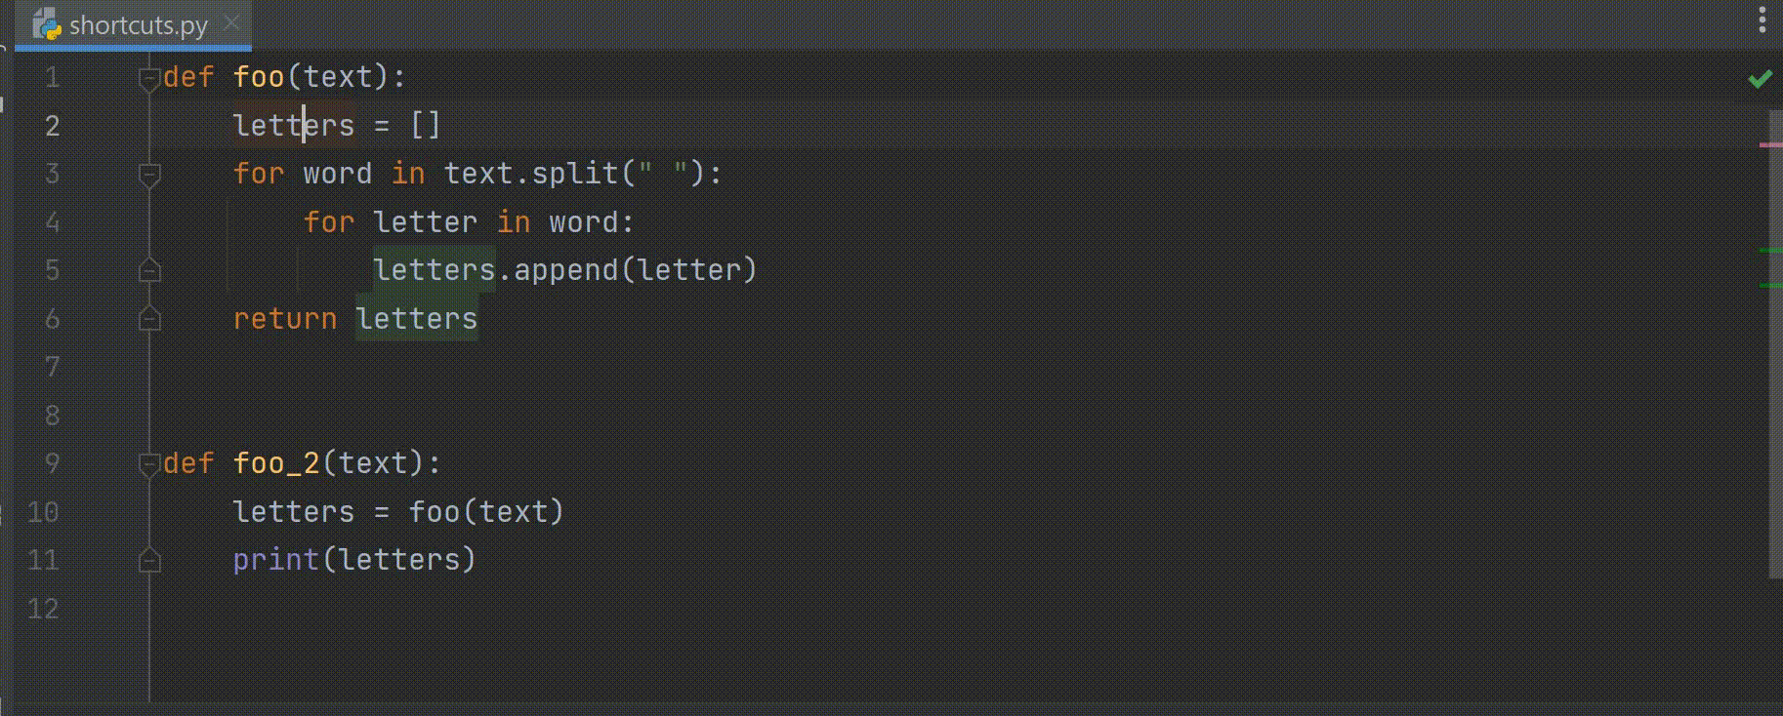
Rename

Slide 18
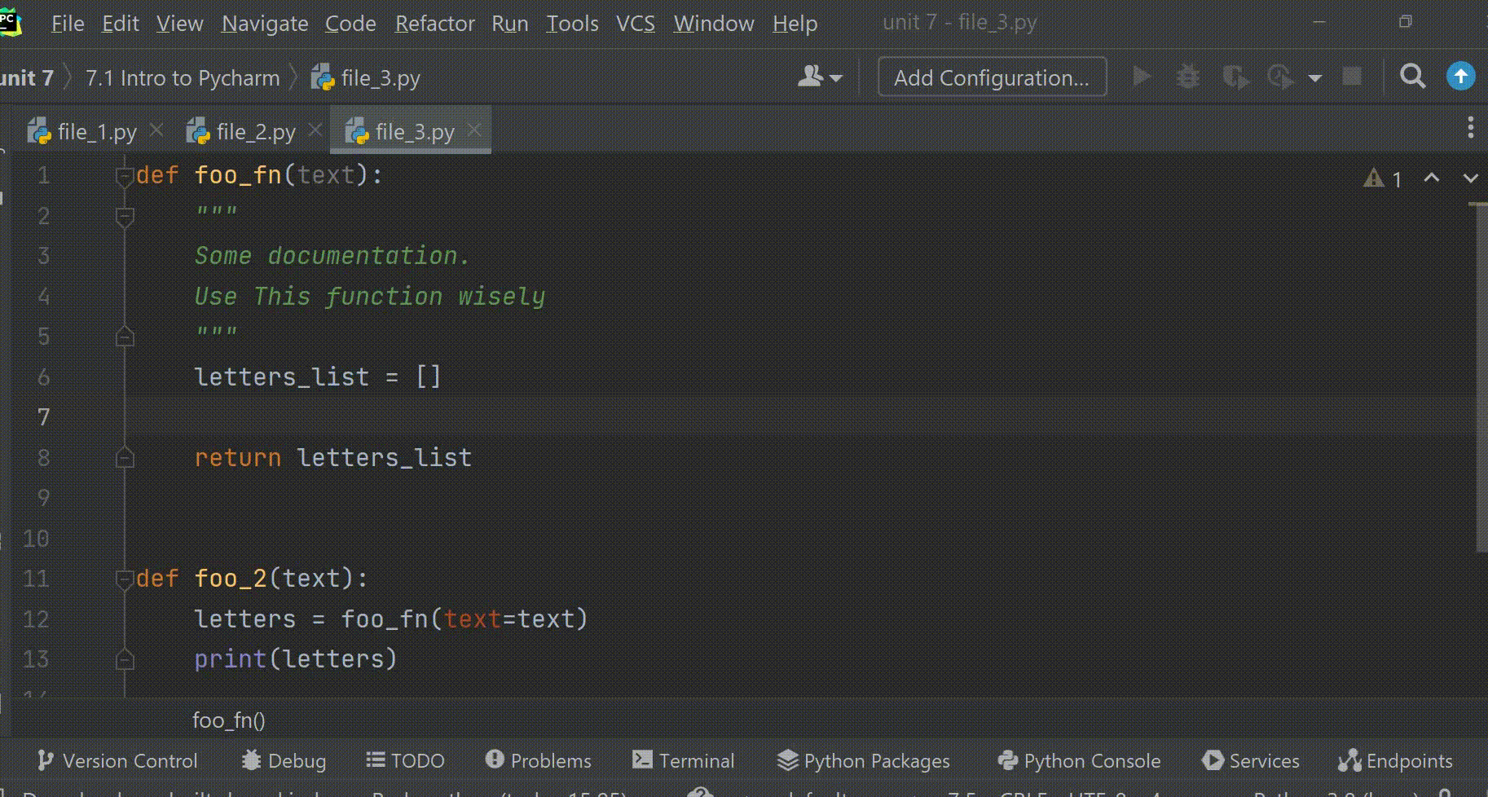
Smart Completion

Slide 19
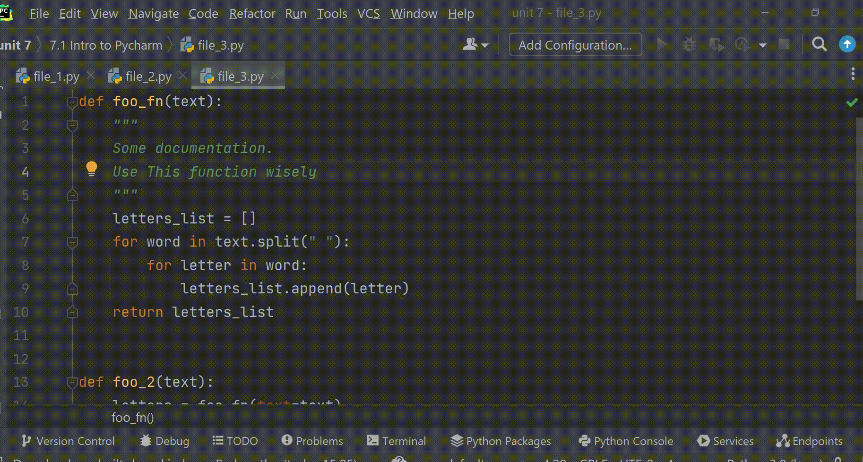
Documentation, Param & Referencing

Slide 20
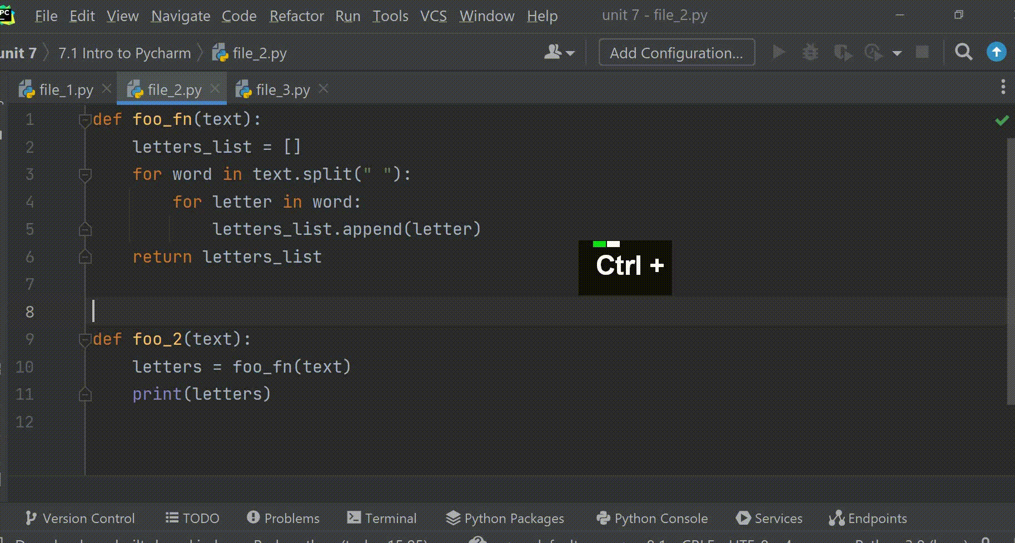
Navigating Windows

Slide 21
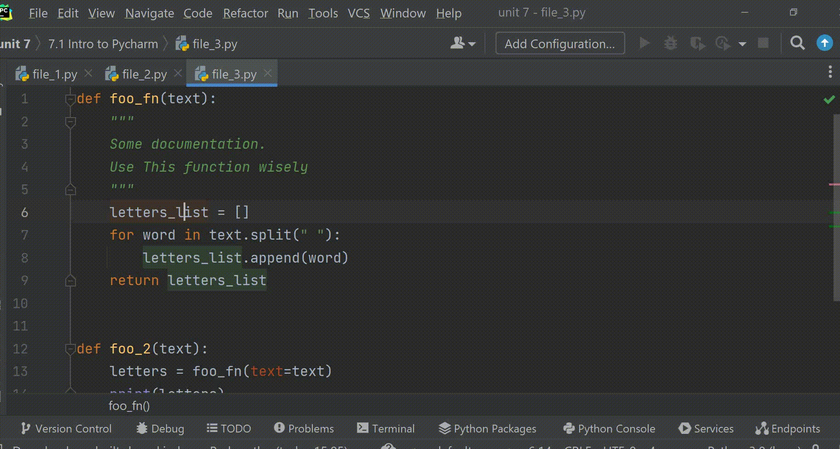
Search Actions & Create Shortcuts

Slide 22
Code With Me

Slide 23
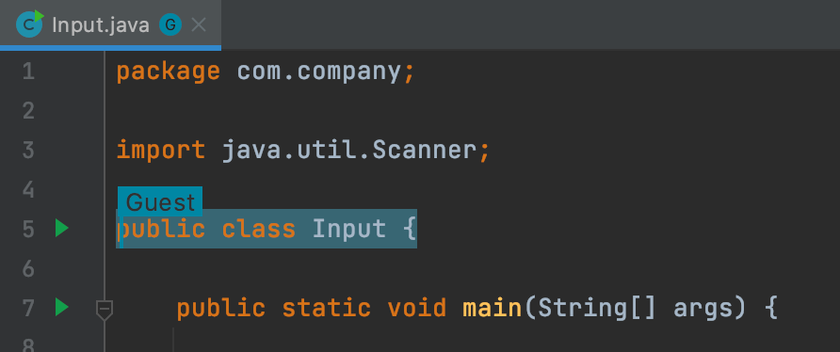
Code With Me
Code With Me is a PyCharm plugin that will allow you to code collaboratively, like in google docs.

Slide 24
Working with VMs

Slide 25
Virtual Machines
Pycharm Professional allows you to work on a remote virtual machine.
The following slides will take you step by step in the process of configuring a remote machine in PyCharm.

Slide 26
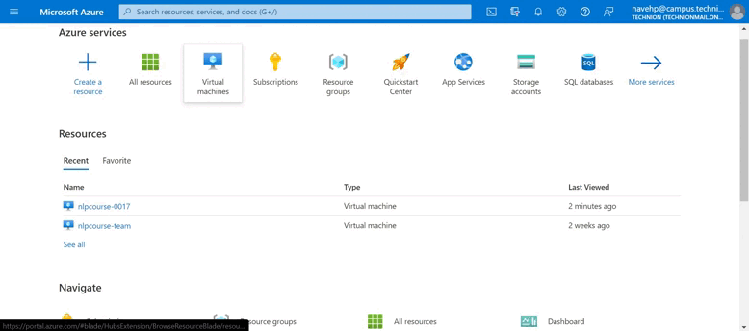
Turn on the Machine
Visit the Azure Portal at https://portal.azure.com/#home
Go into the Virtual Machines section.

Slide 27
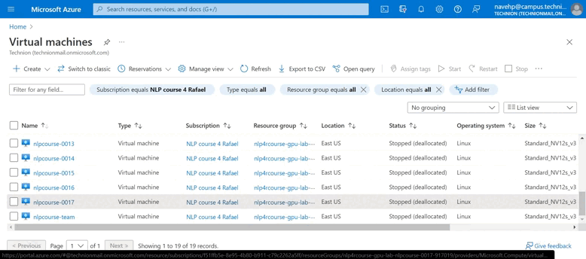
Turn on the Machine
Check you’re on the courses subscription.
Enter your machine’s page and click start.

Slide 28
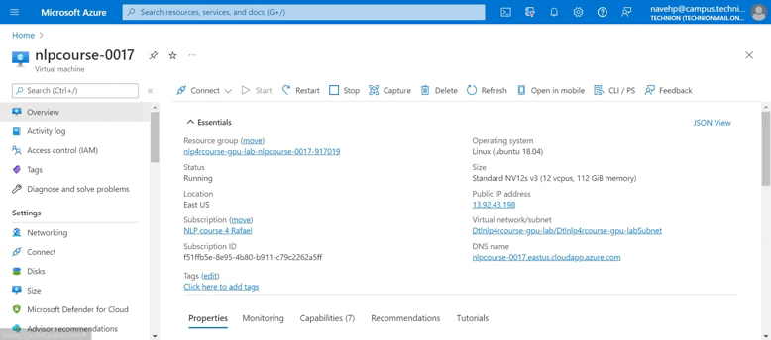
Turn on the Machine
Once the machine has started, go into the connect section and copy the ssh connection command

Slide 29
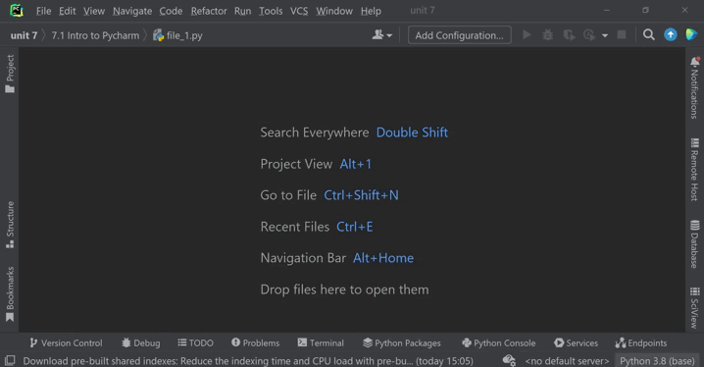
Configure The VM in PyCharm
Configure a new ssh interpreter.
The domain is part of the command you copied.
The username should be student
The password is Technion2021!

Slide 30
Configure The VM in PyCharm
Once you connected to the machine, your interpreter will be found at /anaconda/envs/py38_default/bin/python
In the Sync Folders section enter your local project directory and the remote one. An example of the remote path would be /home/student/project_dir

Slide 31
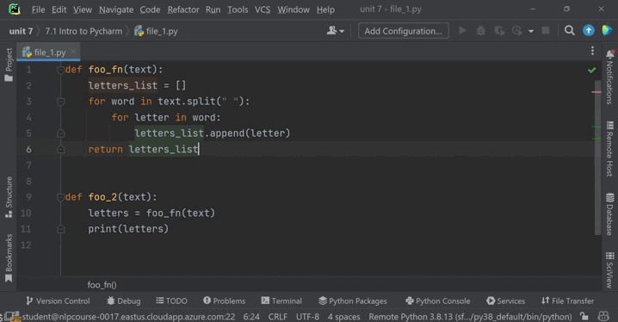
Uploading Files & Browsing
Even though PyCharm will now automatically sync files from your local dir to the remote one, you can manually upload files using the Ctrl + Alt + Shift + x shortcut.
You can browse the remote server via the Remote Host pane.

Slide 32
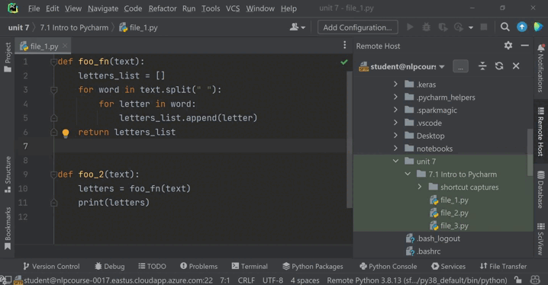
SSH Sessions
You can now run an ssh session of your remote machine using tools > start ssh session.

Slide 33
Question
Configure you own machine!

Slide 34
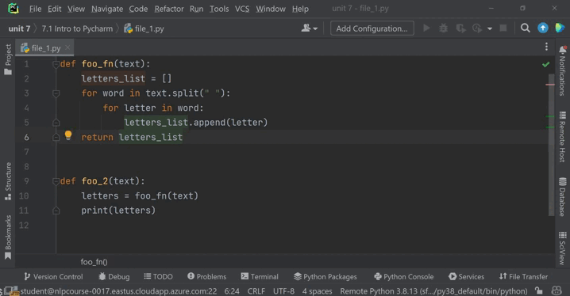
Question
Configure Ctrl + Alt + Shift + s as a shortcut for starting a ssh session.

Slide 35
Bash

Slide 36
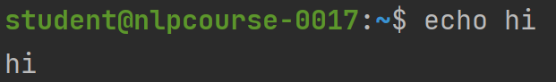
Echo

Slide 37
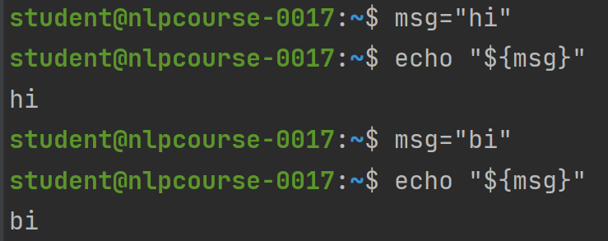
Variables

Slide 38
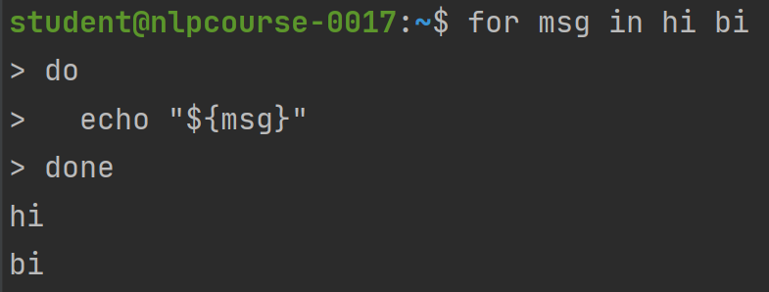
For Loops 1

Slide 39
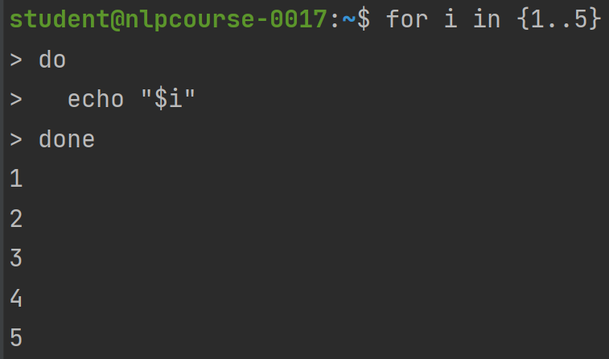
For Loops 2

Slide 40
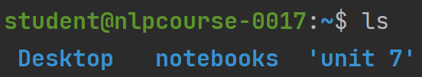
ls – listing directories

Slide 41
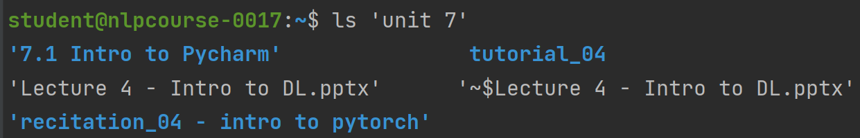
ls – listing directories

Slide 42
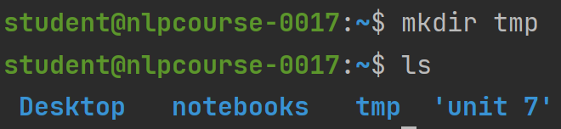
Mkdir – making directories

Slide 43
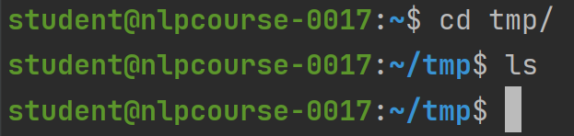
cd – changing working directory

Slide 44
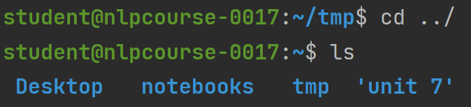
Changing to parent directory

Slide 45
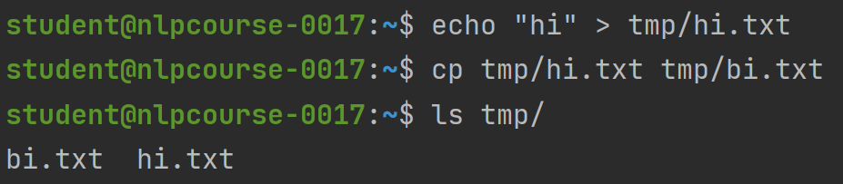
cp – copy files

Slide 46
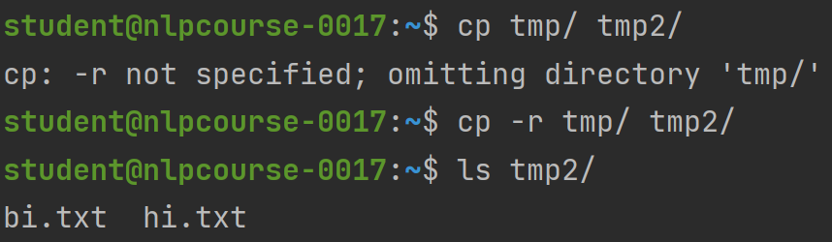
cp – copy files

Slide 47
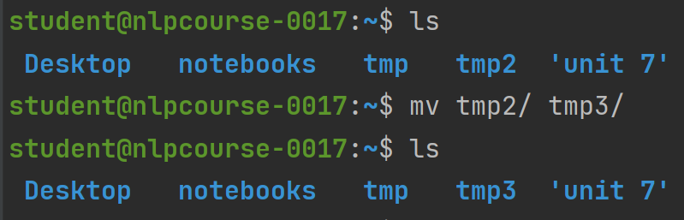
mv – moving and renaming files

Slide 48
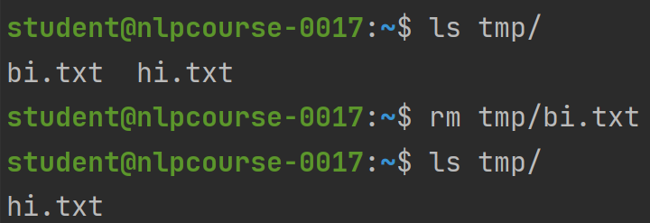
rm – removing files

Slide 49
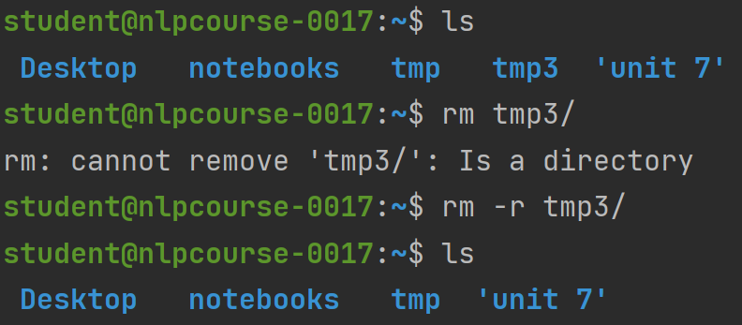
rm – removing diretories

Slide 50
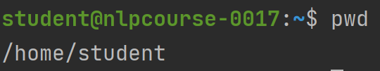
pwd – getting absolute path

Slide 51
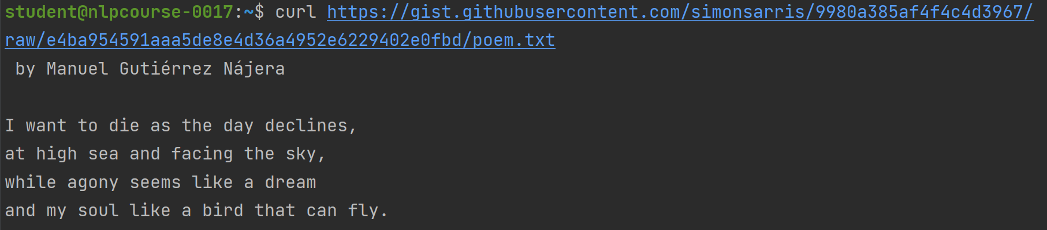
curl – get web pages

Slide 52
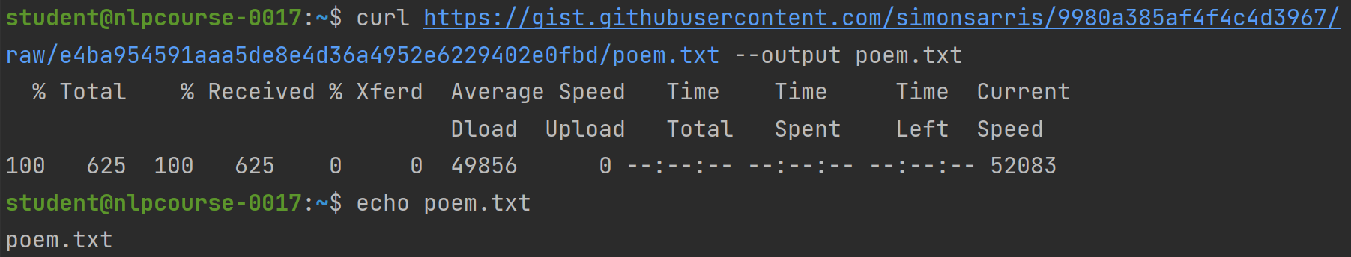
curl – save web pages

Slide 53
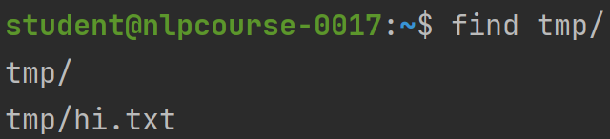
find – finding files

Slide 54
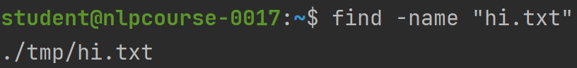
find – finding files

Slide 55
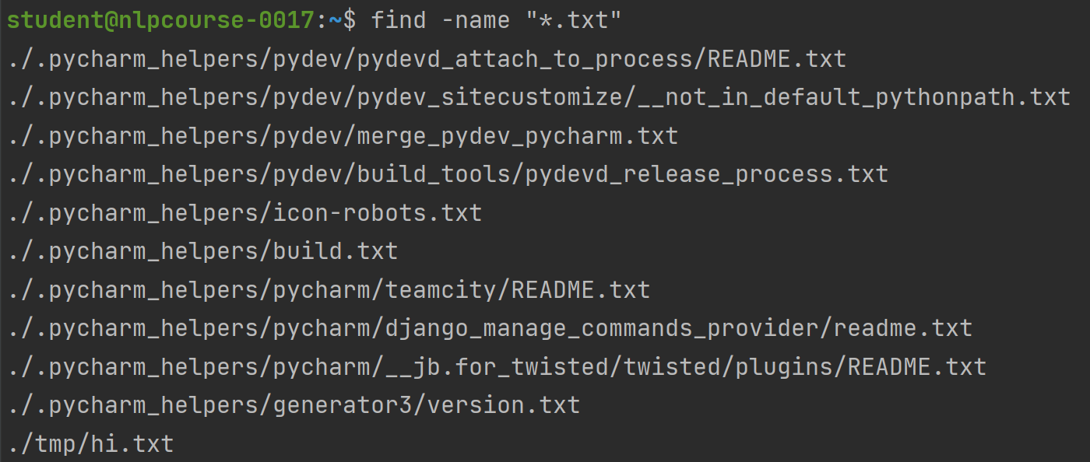
find – finding files

Slide 56
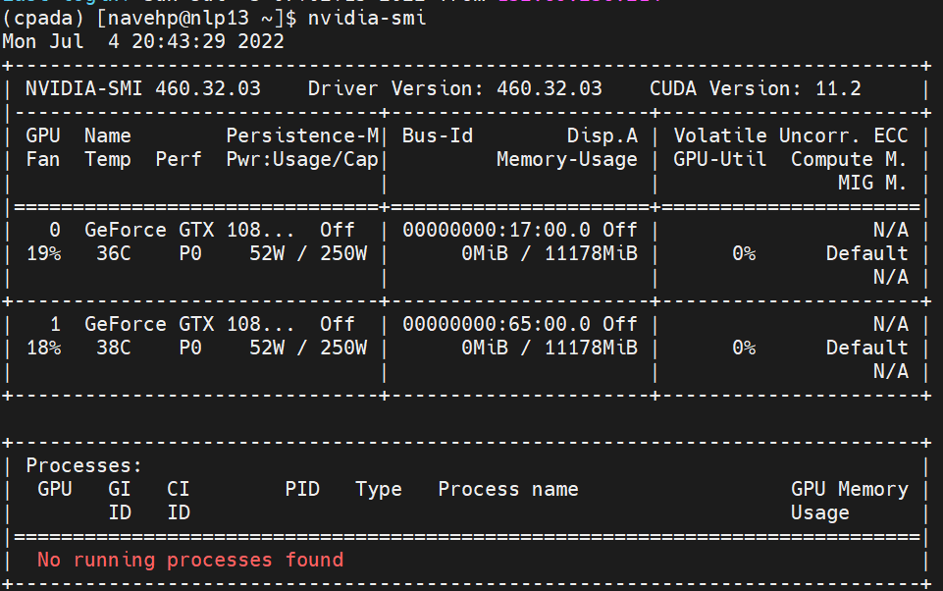
nvidia-smi – monitoring gpus

Slide 57
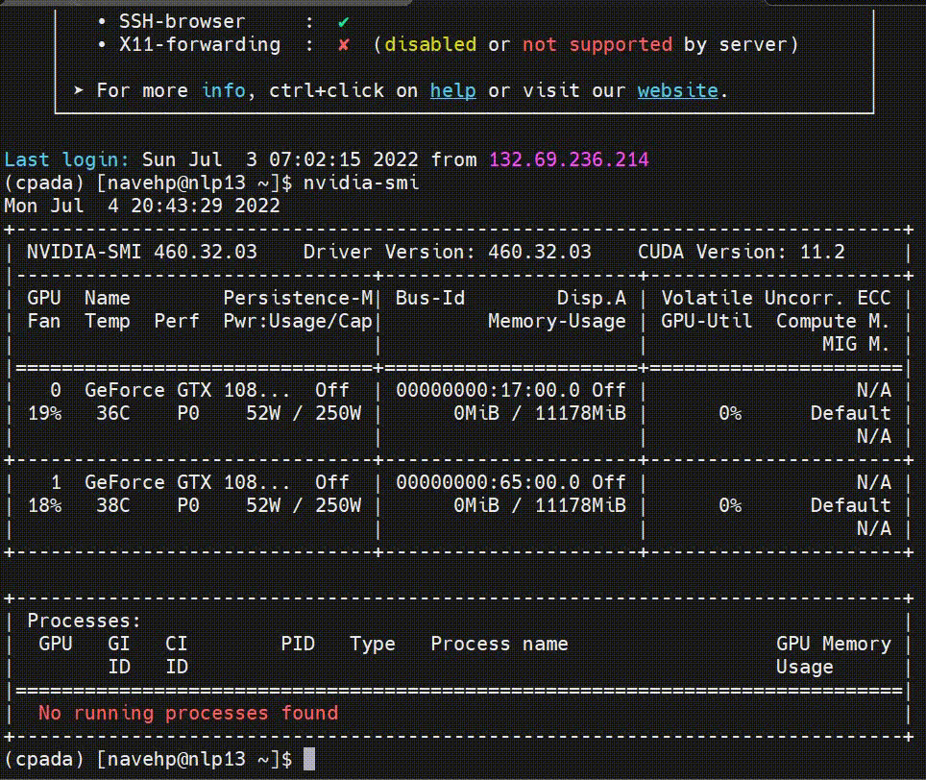
clear – clearing outputs

Slide 58
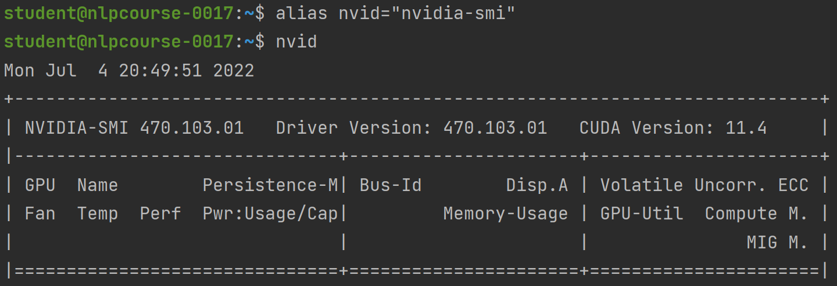
aliasing – creating your own commands

Slide 59
vi – file editing
The vi command allows you to inspect and edit files inside bash.
Run vi file_path to enter the vi editor.
Vi has two modes: command and insert mode.
To enter insert mode, press i.
After editing your file, press escape to exit insert mode.
You can quit your file in the following ways:
:q – quit an unchanged file.
:wq – write and quit a changed file.
:q! – force quitting a changed file without saving.

Slide 60
Screen – running processes in the background
Many times, we would like to run processes in the background and have them not shut down once we disconnect ourself from the machine.
Screen sessions are bash sessions that continue to run in the background.
To create a new screen session run
screen –S session_name
To detach from a screen session press
Ctrl a + d
To reattach to a screen session run
screen –r session_name

Slide 61
Screen – running processes in the background
To kill a screen session run
screen –XS session_name quit
Or press Ctrl a + k
Scrolling isn’t available inside screen sessions.
To move around, enter copy mode by pressing
Ctrl a + [

Slide 62
Sudo
To install things in bash you need sudo privileges.
You do not have sudo privileges on your machines, but if you run into something you need, contact us.

Slide 63
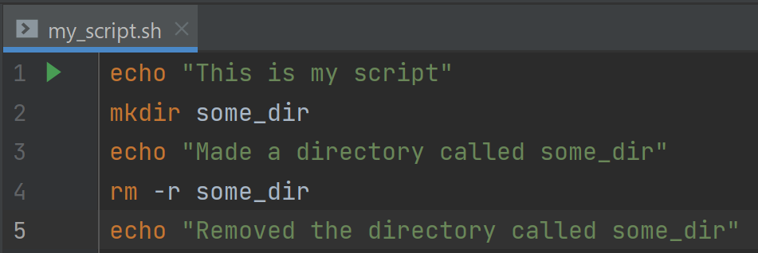
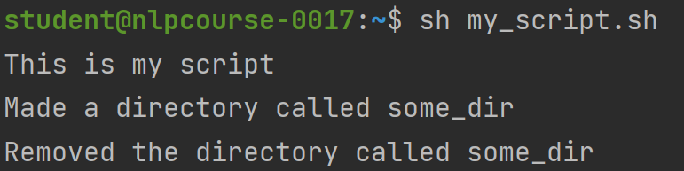
bash scripts
You can place bash commands in a shell script and run it:

Slide 64
Question
Write a bash script called “download_alice.sh” that:
Creates a directory called alice.
Saves the alice book from github to the file alice_book.txt inside the dir.
Renames the file to alice.txt.
Prints the first 3 lines from the book (search the web!)
Prints informative messages between commands.
Run the script

Slide 65
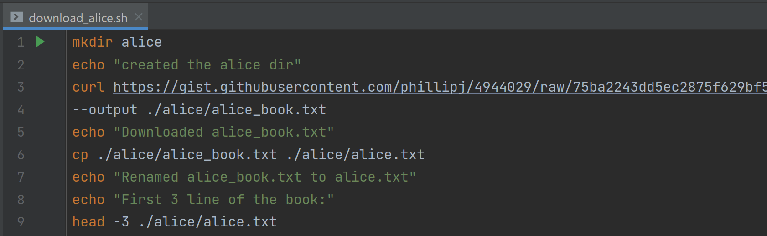
Solution

Slide 66
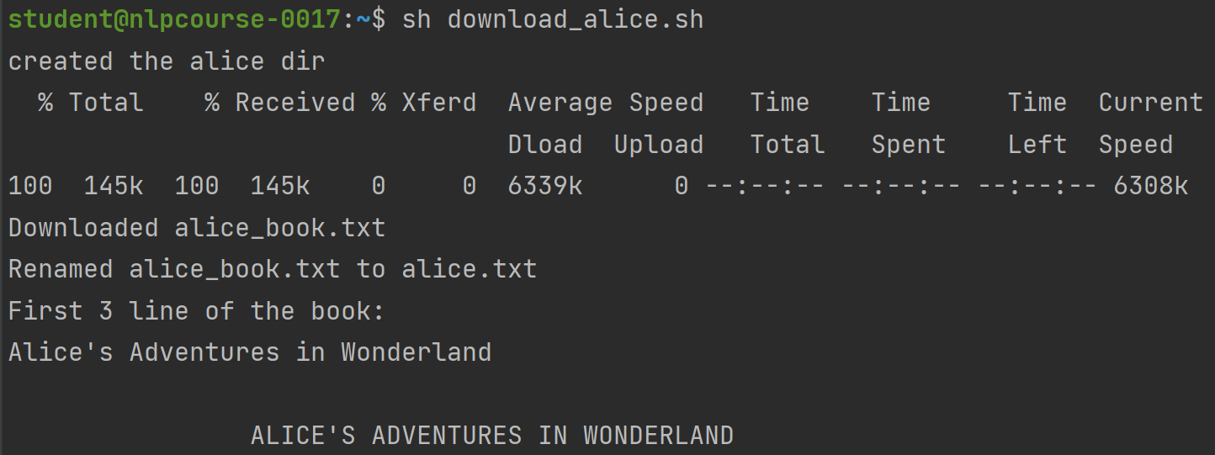
Solution

Slide 67
Coding Practices

Slide 68
How to Write SOLID Code
Single-responsibility principle (SRP)
Open–closed principle (OCP)
Liskov substitution principle (LSP)
Interface Segregation Principle (ISP)
Dependency Inversion Principle (DIP)

Slide 69
How to Write SOLID Code
Single-responsibility principle (SRP)
Open–closed principle (OCP)
Liskov substitution principle (LSP)
Interface Segregation Principle (ISP)
Dependency Inversion Principle (DIP)

Slide 70
Single-Responsibility Principle
Every component of your code should have one and only one responsibility

Slide 71
Open-Closed Principle
You should not need to modify the code you have already written to accommodate new functionality, but simply add what you now need.

Slide 72
Liskov Substitution Principle
Derived classes must be substitutable for their base classes

Slide 73
How to Write DRY Code
Don’t Repeat Yourself
Every piece of knowledge or logic must have a single, unambiguous representation within a system.

Slide 74
Example Project

Slide 75
Debugging

Slide 76
PyCharm Debugger
Live demonstration. A tutorial can be found here.

Slide 77
Some More Good Practices
Splitting code into logical files.
utils.py file.
consts.py file.
Using pathlib for paths.
Documentation
Configurable Code (e.g. YAML)
Using argparse to run code from shell.
Reformatting the code to PEP-8: Ctrl + Alt + L in PyCharm

Slide 78
Loggers

Slide 79
Wandb
Live demonstration.
A tutorial can be found here.
Sweeps – We will use sweeps late on in the course. A tutorial can be found here.
Clear ML is another (Israeli) logger that has some great features.

Slide 80
Tutorial

Slide 81
Task
Take the existing project and add the following features:
Choice between an RNN/LSTM/GRU in the model.
Choice if to load pretrained embedding weights or not.
Whether to print the loss and accuracy in the evaluation loop.
Write evaluation results to csv
Bonus: Create a hyperparameter search script that finds good hyperparameters.

